Slide 1
Phishing Attack Simulation and Mitigation
Jeffrey Resto

Slide 2
Jeffrey Resto
All
About
Phishing
Attacks

Slide 3

What is a phishing attack?
Jeffrey Resto
Phishing is a type of cyberattack that uses fraudulent emails, text messages, phone calls or websites to trick people into sharing sensitive data.
Common vulnerabilities that may be exploited include communication protocols such as emails, websites, text messaging, or even phone calls.
Most phishing attacks appear legitimate but be cautious of anyone asking for:
Sensitive information
Money
Caution

Slide 4
Jeffrey Resto
Motivation | Background | Previous Research
We chose this topic because of how prevalent it is in the world today. We’ve all be subject to this form of attack.
Ex: A suspicious email, a phone call about extending your cars warranty.
Phishing is dangerous! It targets people through social engineering, the most vulnerable of which are those not well informed on the attack.
In 2010, Jason Hong's, "The State of Phishing Attacks", summarized phishing techniques into different categories:
Spear phishing
Whaling
Clone phishing
Studies show that multi-factor authentication reduces the success of phishing attacks by over 90%.
Research

Slide 5
Continued …
Jeffrey Resto
Spear Phishing
Whaling
Clone Phishing
A type of phishing campaign that targets a specific person or group and often will include information known to be of interest to the target, such as current events or financial documents.
Whaling is a common cyber attack that occurs when an attacker utilizes spear phishing methods to go after a large, high-profile target, such as executives.
Clone phishing is a newer type of email-based threat where attackers clone a real email message and resend it pretending to be the original sender. Any attachments are replaced with malware.

Slide 6
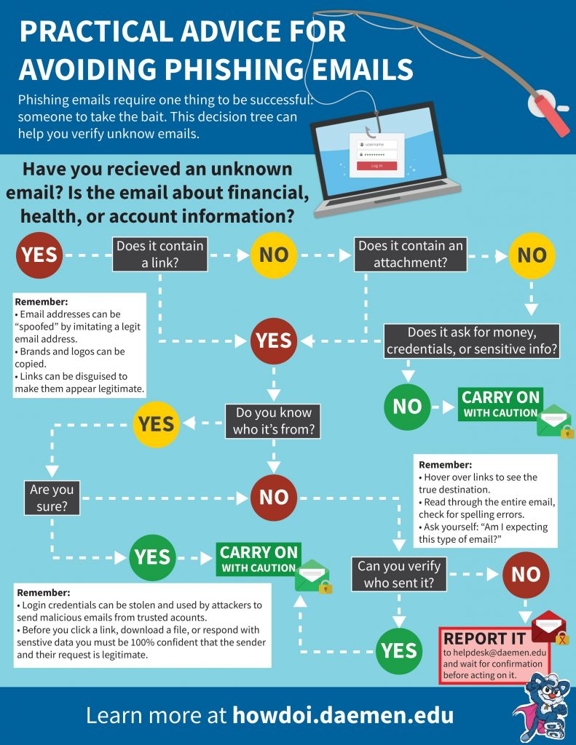
Problem
Jeffrey Resto
Identification
Project Goals:
For this project we will be simulating a phishing attack.
We aim to implement this cyber attack in hopes to teach the dangers as well as how to protect yourself against it.
Expected Outcomes:
We anticipate successfully blocking phishing attempts on our victim.
Success will be measured by our ability to protect the victim and have the process be automated for them.

Slide 7
Technical Approach
Jeffrey Resto
Program
We developed a program using Natural Language Toolkit (NLTK) and scikit-learn to detect and eliminate phishing emails. First we extract the text from the body of each email and convert it into a string.
NLTK is used to preprocess the text ensuring the data is suitable for analysis.
A dataset of previous spam and regular emails were then used to train the program with scikit-learn.
Once trained, the model analyzes incoming email text to determine whether it is spam or not, and gives a confidence score each time.
If an email is identified as phishing, the program automatically detects and deletes it.
NLTK:
Handled the natural language cleanup and transformation, making the email content usable for training and prediction by the machine learning model.
SCIKIT Learner:
Provided the tools to convert text into data and trained the program to check emails with confidence.

Slide 8
Technical Approach …Continued
Jeffrey Resto
Website
Steps
We created a fake phishing website by replicating the original HTML source code of LinkedIn.
In order to do so we modified the action attribute within the login form to redirect user input to our system instead of the actual LinkedIn server.
This allowed us to capture and store the login credentials entered by users, successfully phishing our victim.
Obtained HTML Source Code:
Copied the full HTML source code of the page to replicate its appearance.
Modified the Form Action:
Located the <form> tag in the HTML.
Changed the action attribute so that form data would be submitted to a local file instead of LinkedIn’s actual server.
Captured User Input:
Received and stored the submitted credentials (username and password) from the form.

Slide 9
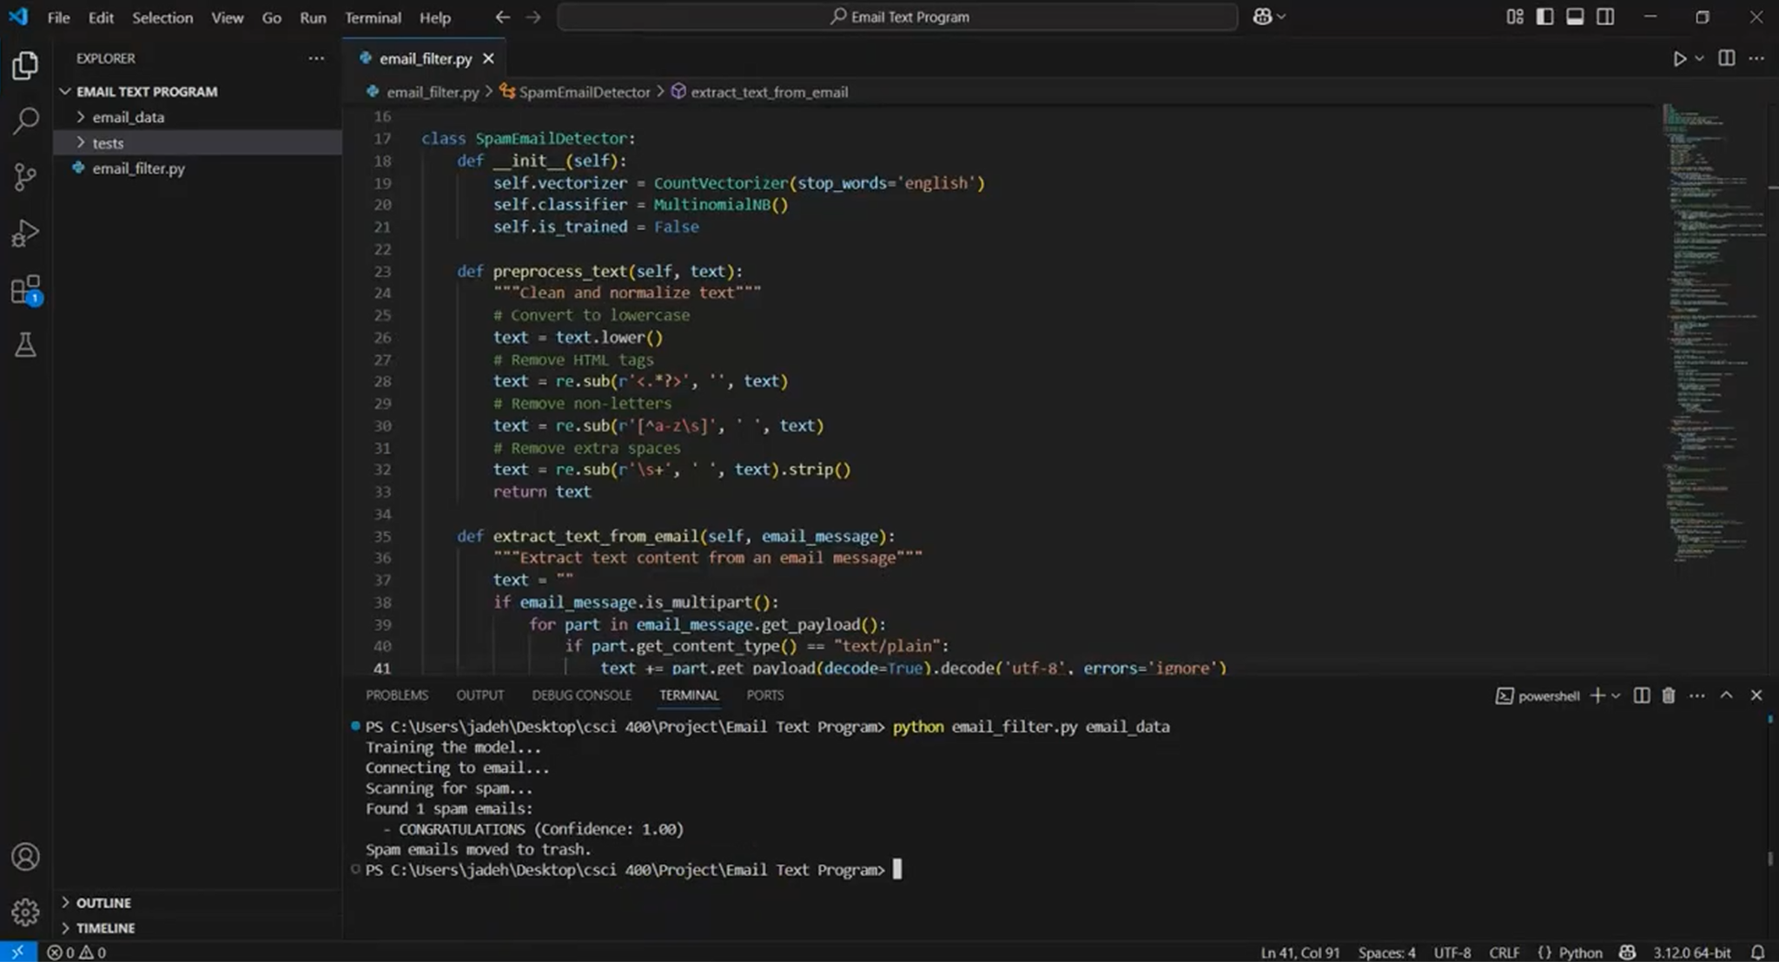
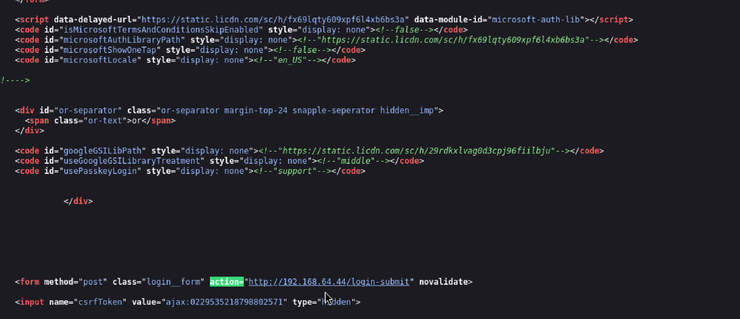
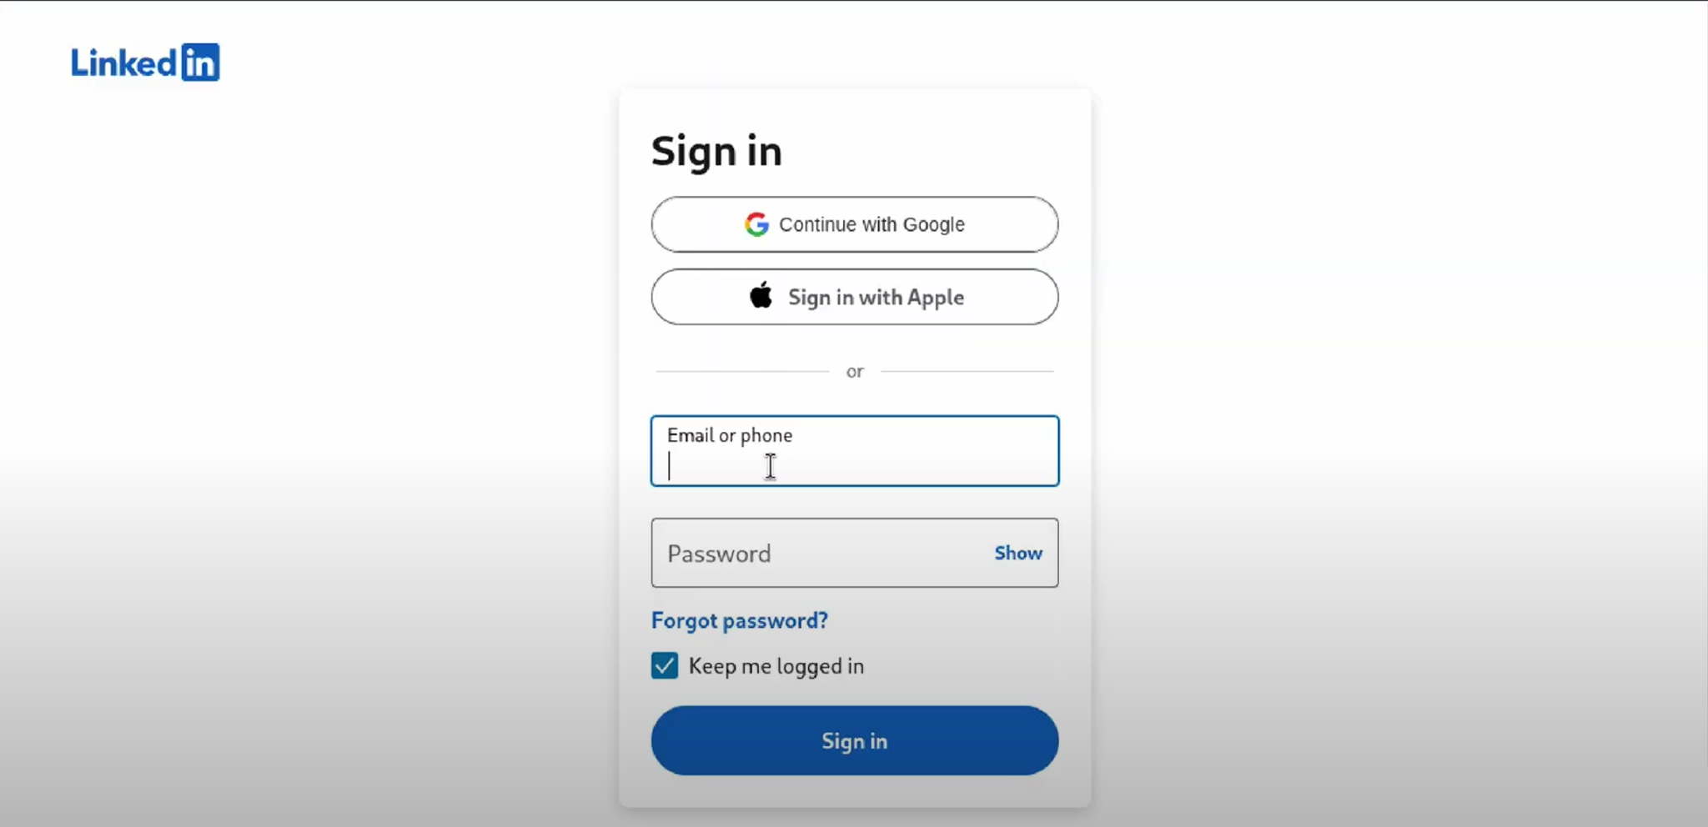
Network Topology and System Setup
Jeffrey Resto

Slide 10
Experiment Steps
Jeffrey Resto
Step
By
Step
1
Created counterfeit website.
Copied existing code of legitimate site.
2
Sent false email.
If user takes the bait their information will be stolen.
3
Program scans email for potential threats.
Program will alert if threat is detected as well as provide a confidence score.
4
Malicious email will be automatically deleted.
Program will stop once all threats are neutralized.

Slide 11
Results and Analysis
Jeffrey Resto
Results
Analysis
We were able to successfully execute our goal of preventing, detecting and countering phishing emails using a machine learning based approach.
Using NLTK for natural language processing and scikit-learn for model training and classification, the program was able to accurately identified spam and phishing emails with a high level of confidence.
We set up a fake phishing website, which we used to collect valuable information from the victim.
After detection, the program then automatically deleted the phishing email, effectively preventing harmful emails from reaching the user.
The project was successful due to the combination of natural language processing and machine learning. However, we did run into several challenges during the development phase.
The first versions of the model required our input to execute the deletion of spam emails. We also had difficulties with the model's sensitivity, setting the threshold too low, which resulted in false positives.
Creating the fake website also presented challenges, mainly the form redirection and information capture, which required constant readjustments.
Overall, despite these hurdles, the project was a success.

Slide 12
Jeffrey Resto
Prevention
Detection
Counter
Measures

Slide 13
Prevention | Detection | Countermeasures
Jeffrey Resto
Prevention
Detection
Countermeasures

Slide 14

Prevention Mechanisms
Jeffrey Resto
In this experiment, prevention focused on limiting exposure to phishing attacks by proactively identifying and eliminating threats.
Using machine learning models trained on datasets of spam and actual emails, the system was made to prevent phishing content from ever reaching the user.
This approach allowed us to reduce reliance on user awareness.
Although there are strong systems in place, bad actors are constantly improving. make sure to stay up to date with new schemes!
Caution

Slide 15

Detection Mechanisms
Jeffrey Resto
Detection was the core component of this project, using natural language processing with NLTK and scikit-learn to scan the contents of incoming emails.
The email body was converted into structured string data and then compared against examples of previous spam and phishing attempts.
The program gave a confidence score to each email, classifying it as either phishing or legitimate.
Which is why we were able to automate the detection of malicious messages without false positives.
Always take threat detection seriously! Whether malicious or a false positive, it's better to be safe than sorry!
Caution

Slide 16

Countermeasures
Jeffrey Resto
Upon successful detection of a phishing email, the systems automated countermeasures eliminated the threat.
This includes deletion of the suspicious email and keeping its metadata to help future detection.
These countermeasures ensured that threats were not effective, highlighting the system’s reliability in protecting users.
While countermeasures can be effective, always exercise caution! New malicious activity can slip past older systems.
Caution

Slide 17

Conclusion
Jeffrey Resto
What’s a hacker’s favorite season?
… Phishing season.
In conclusion, this project demonstrated the effectiveness of combining natural language processing and machine learning techniques to detect and eliminate phishing threats. By training our model, we were able to identify and remove phishing emails with high confidence. The creation of a fake phishing website gave us the opportunity to test our project in a safe, controlled environment. While the development process did have a few technical challenges, including inconsistencies and threshold sensitivity, the final result was successful in automating email threat detection. This project not only deepened our understanding of phishing but also showed us the importance of having proactive cybersecurity measures in place.

Slide 18

Future Recommendations
Jeffrey Resto
Tips
Suggestions for Future Work:
As we continue to evolve technologically our solutions will follow suit.
AI is the future and there will be new programs created for the sole purpose of filtering out potentially dangerous phishing attacks, we may one day be able to eliminate the problem altogether.
Potential Enhancements and Mitigation Strategies:
For now we believe the best strategy to counteract phishing scams is to raise awareness.
Teach not only the younger generations but the older ones as well, the less you know the more vulnerable you are.
Phishing attacks are evolving. Protect yourself by completing awareness training. This training helps people recognize fraudulent messages as well as visual indicators.

Slide 19
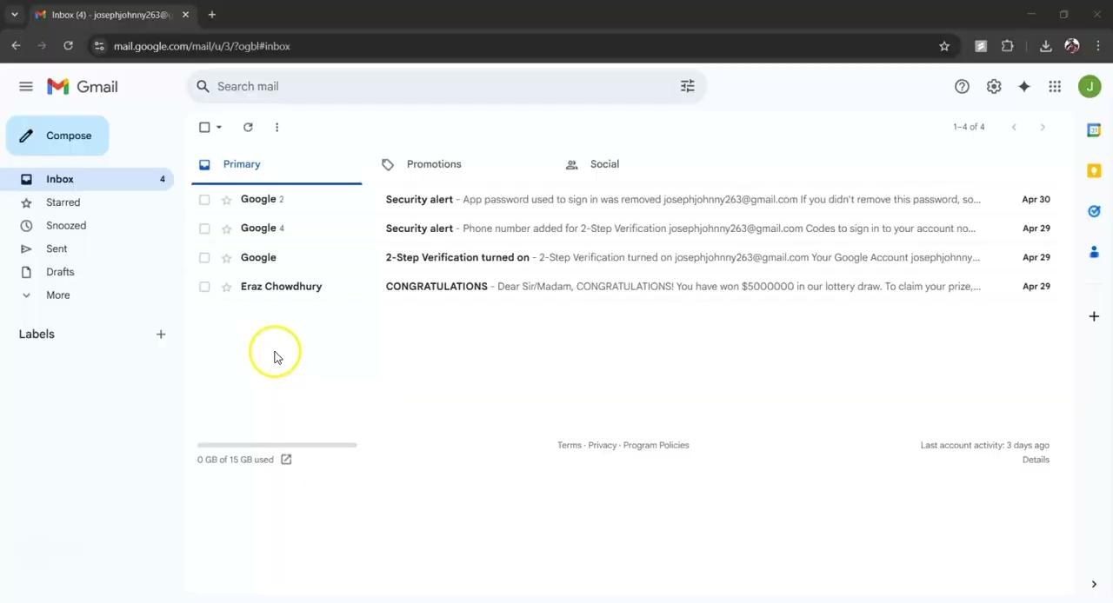
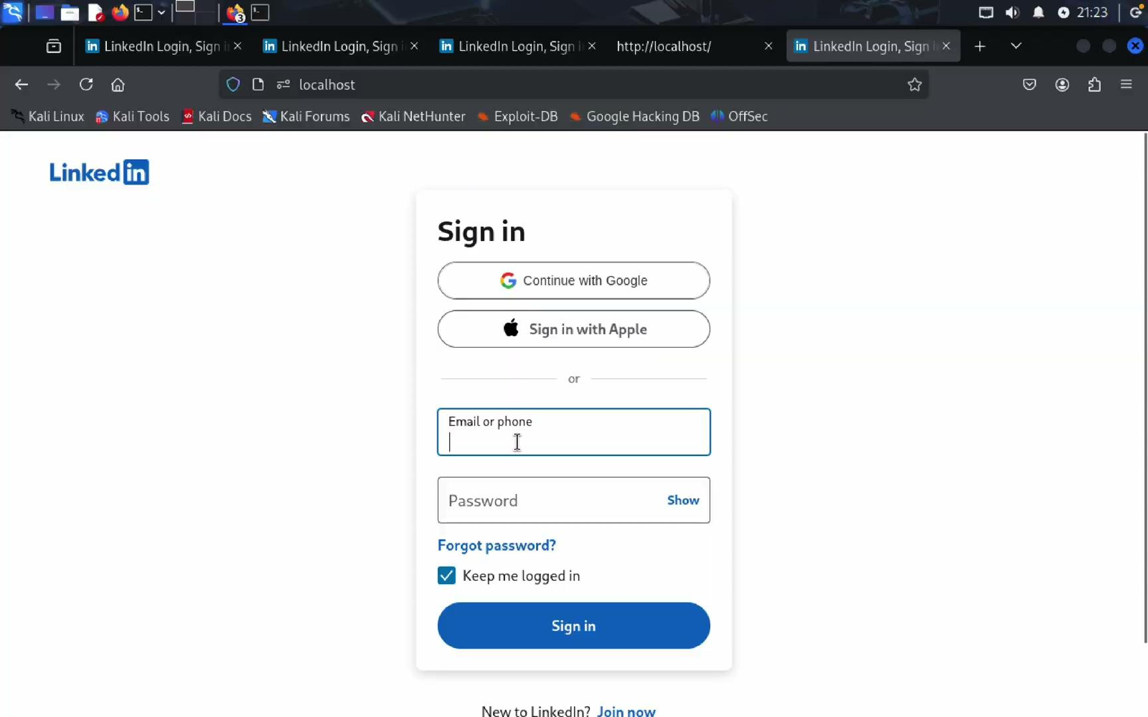
Demo
Jeffrey Resto

Slide 20
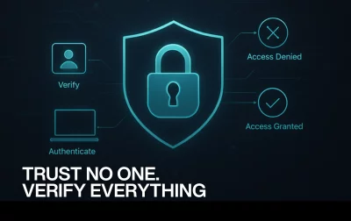
References
Jeffrey Resto
“What Is Phishing?” IBM, Matthew Kosinski, 17 Apr. 2025,
www.ibm.com/think/topics/phishing.
Hong, Jason. "The State of Phishing Attacks."
Communications of the ACM, 2012.
https://www.nltk.org/
https://caniphish.com/blog/how-to-create-a-phishing-website?utm_source=chatgpt.com

